Slide 1
RENEWABLE ENERGY IN CANADA: An Overview Seminario Americano De Derecho Ambiental – October 2014
Jennifer Danahy
Partner, Environmental Law Group
Certified Specialist in Environmental Law

Slide 2
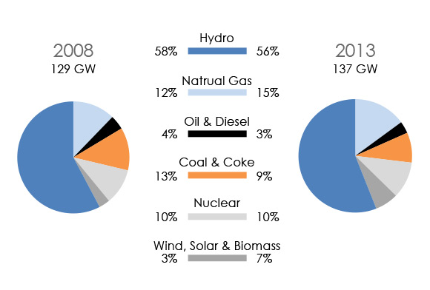
CANADA’S ENERGY PROFILE 2008 to 2013
Source: National Energy Board

Slide 3
The Constitution Act, 1867
Who governs electricity in Canada?
Canada is a federalist nation, meaning that Canada’s
federal government,
ten provincial governments,
three territorial governments, and
thousands of municipalities
all have roles to play in energy regulation.
Provincial governments are responsible for resource management, including production, transmission, and distribution of electricity. As a result, energy policies and regulation vary from province to province.
The federal government is involved in the inter-provincial and international movement of energy.

Slide 4
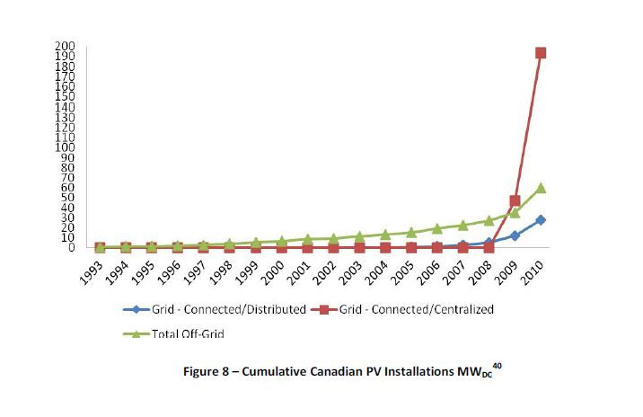
SOLAR ENERGY IN CANADA
The PV market grew 5.5 times per year for the period between 2006 to 2012. Canadian solar PV market is expected to grow from less than 500 MW per year between 2011 and 2015 to up to:
1,000 MW per year from 2016 to 2020
1,500 MW per year from 2021 to 2025
Source: Natural Resources Canada

Slide 5
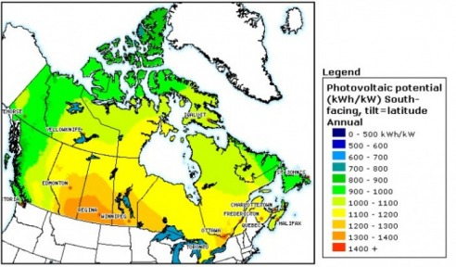
SOLAR ENERGY IN CANADA
Ontario is Canada’s leader in solar energy
By October, Newboro 1 will be up and running, a project consisting of 55,000 solar panels across 120 acres, which will generate 10 MW of energy for Ontario’s grid.
A 100 MW solar farm of 450,000 panels, covering 750 acres, is currently under construction in Southern Ontario.
Source: Solexium Solar Solutions

Slide 6
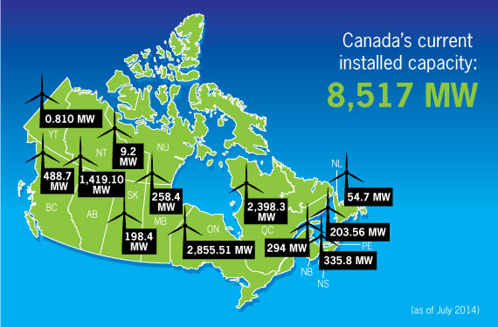
WIND ENERGY IN CANADA
Sample Provincial Targets
Ontario – 4600 MW by 2020
Quebec – 4,000 MW by 2016
Manitoba – 1,000 MW by 2016
Canada ranks 9th in the world (4,862 MW of installed capacity) – enough power to meet the needs of 2 million homes.
2012 saw 936 MW of new capacity ($3.0 billion), a growth of almost 20%.

Slide 7
ONTARIO - A Case Study
Statistics (July 2014) – Wind
Total installed capacity: 2,855.51 MW
Number of projects: 57
Number of wind turbines: 1,498
Statistics (July 2014) – Solar
70 projects contribute about 1% of Ontario’s power
Ontario leads Canada in wind energy, supplying over 3% of the province’s electricity demand.
Ontario is the first jurisdiction in North America to eliminate coal as a source of electricity.
Over 1 billion was invested in installing more than 420 MW of new wind capacity in 2013.
Over 300 MW of new wind capacity was commissioned this year, prior to July.

Slide 8
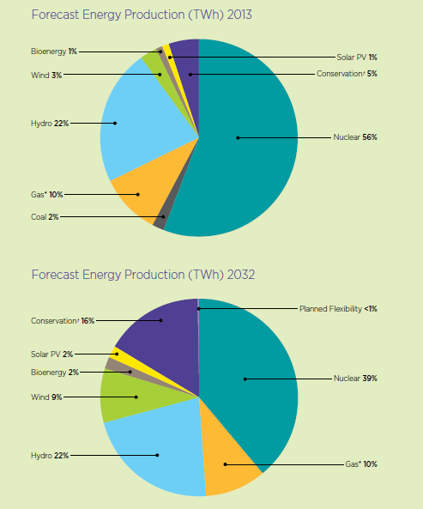
ONTARIO’S FEED IN TARIFF (FIT) PROGRAM
The FIT Program was launched in 2009, and is enabled under the Green Energy and Economy Act.
The Ontario Power Authority is responsible for implementing the Program.
4 renewables are eligible: bioenergy, solar PV, waterpower and wind
Incentives are provided to Aboriginal, community, municipal and other public sector projects:
a maximum amount of MWs of contract capacity are set aside for each of these categories
price adders are available for projects with 15% or more participation from municipalities, public sector entities, communities, or Aboriginal groups
Energy Production Forecast: Ontario
Source: Government of Ontario

Slide 9
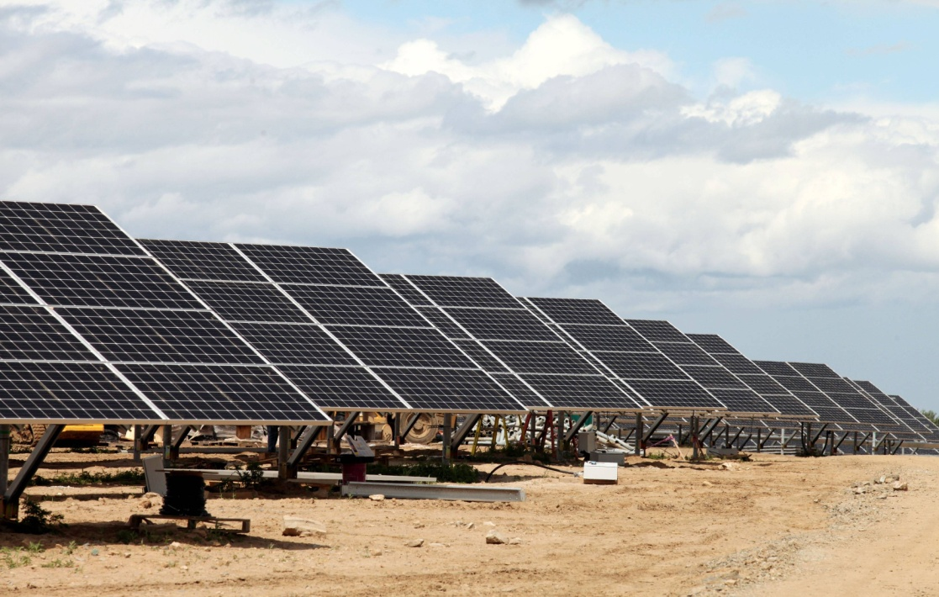
ONTARIO’S FIT PROGRAM cont’d
The FIT program guarantees that the OPA will buy energy from the producer at a set price for a set contract length. This price tends to far exceed the market rate. Contract lengths are 20 or 40 years (waterpower projects only).
Example: The Newboro solar project will receive 44 cents/kWh for energy for the next 20 years, three times the retail electricity rate.
Source: The Globe and Mail

Slide 10
RECENT CHANGES TO THE FIT PROGRAM
Renewable energy projects greater than 500 kW (largeFIT projects, such as the Newboro project) are no longer eligible. New projects will instead be procured as part of a competitive bidding process.
This was a response to concerns about upward pressure on electricity prices, and slower demand growth
Ontario will determine how much power it wants to buy, developers will submit project plans and their electricity price. Generally, the lowest bidders will get the contracts, as long as their projects meet certain criteria, such as being in a location where power is needed
“Domestic content” requirements eliminated to comply with WTO ruling that such requirements violated Canada’s trading obligations.
Renewed commitment to small scale projects:
Annual procurements targets, beginning in 2014, set at 150 MWs for SmallFIT projects (500kW or less) and 50 MW for microFIT projects (10 kW or less).

Slide 11
APPROACHES OF OTHER CANADIAN JURISDICTIONS
The country’s three next-largest wind markets all have plans to
push renewable energy forwards:
British Columbia – BC does not have a FIT program, as BC’s energy is already 90% clean. BC’s Energy Plan establishes a Innovative Clean Energy Fund of 25 million dollars to help clean power projects succeed.
BC has 247.5 MW of installed wind power, following successful bids under BC Hydro’s Clean Power Calls.
BC also plans to implement a Bioenergy Strategy to build on BC’s natural bioenergy resource advantages.
Quebec – Quebec has completed an inventory of commercial-viable wind energy potential for the entire province.
Plans on calling for bids for 500 additional MW of wind power, reserved for regions and First Nations.
Alberta – Alberta is the only deregulated merchant market in Canada. Alberta is currently working on an Alternative Renewable Energy Strategy.
Alberta’s Micro-generation Regulation allows individuals to generate their own environmentally friendly electricity, receiving credit for excess power sent into the grid.
A private power developer currently has plans for a 30 million dollar, 15 MW
solar project in Alberta.

Slide 12
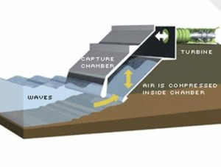
THE MARITIMES
Eastern Canada is also planning for an energy future that includes
Renewable energy.
Nova Scotia – Renewable Electricity Plan is committed to having Nova
Scotia be powered by 40% renewable energy by 2020.
The Plan uses a variety of strategies:
Large and medium sized projects are split between Nova Scotia Power and independent power producers, who will compete for projects in a new process managed by the Renewable Electricity Administrator
Community-based FIT program
Enhanced net metering for individuals and small businesses
Nova Scotia released a Marine Renewable Energy Strategy in 2012, to further research, develop, and regulate marine energy resources.
Diagram of a “Tidal Lagoon”
Source: Renewable Energy Spot

Slide 13
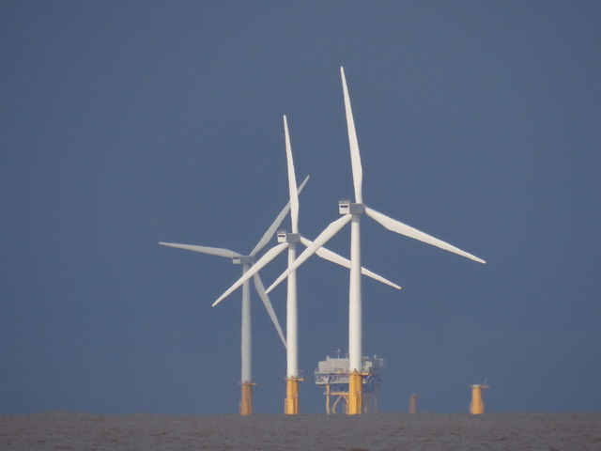

Slide 14
Offices in all major business centres across Canada – Toronto, Hamilton, Waterloo Region, Kanata, Ottawa, Montréal, Calgary and Vancouver
International offices in Beijing, London and Moscow
Seamless 24 hour service around the world
Representative office in Beijing to support its fast growing business acting for Chinese clients
Gowlings’ Renewables Group: active on every continent and in every Canadian jurisdiction

Slide 15
Jennifer Danahy
Partner, Environmental Law Group
Certified Specialist in Environmental Law
Tel: (416) 369-7290
jennifer.danahy@gowlings.com

