Slide 1
Waste to Energy United States Perpectives
Aileen M. Hooks

Slide 2
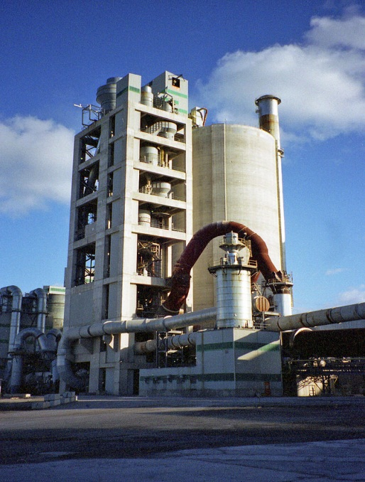
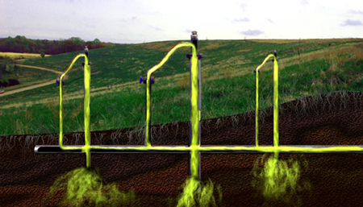
Overview
Waste to Energy projects convert waste into productive use
Common waste to US energy projects include:
Boilers and Industrial Furnaces
Landfill Methane Collection

Slide 3
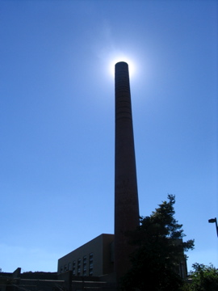
Boilers and Industrial Furnaces (BIFs)
BIFs burn hazardous waste for significant energy and material recovery
Waste treatment is a secondary benefit

Slide 4
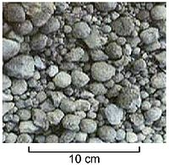
BIFs - Cement Kilns
Cement kilns are a common type of BIF (when burning hazardous waste)
Kilns produce cement by grinding and heating a mixture of raw materials to produce clinker

Slide 5
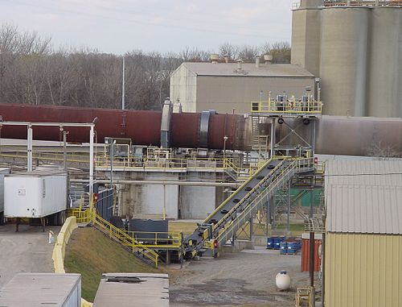
BIFs - Cement Kilns
Cement manufacturing is very energy-intensive
4.4 million Btu = 1 ton of cement
Using waste fuels greatly reduces and can negate fuel costs

Slide 6
Regulatory Challenges
Using waste as fuel implicates regulation under both hazardous waste (RCRA) and air (CAA) laws
RCRA permitting and CAA comprehensive performance testing can be complex and expensive
A federal court recently vacated a long-standing exclusion of "comparable fuels" from RCRA regulation

Slide 7
Landfill Methane
Methane is a potent greenhouse gas
Odor and safety concerns as well
Municipal solid waste landfills are a significant source of methane emissions in the United States
Landfill gas is approximately 50% methane

Slide 8
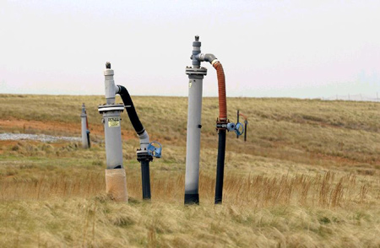
Landfill Methane - Energy Use
Landfill gas can be captured and used to fuel:
Power plants
Manufacturing facilities
Vehicles
Homes

Slide 9
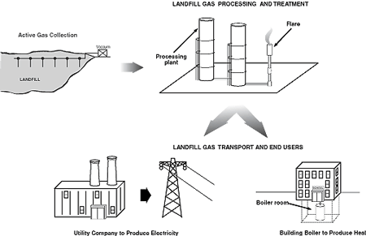
Landfill Methane - Energy Use

Slide 10
Landfill Methane - LMOP
Landfill Methane Outreach Program (LMOP)
U.S. EPA encourages recovery and beneficial use of landfill gas as an energy source
Voluntary assistance program to overcome barriers to project development
Primary LMOP benefits:
Reduces greenhouse gas emissions
Reduces demand for fossil fuels
Reduces landfill odors and increases safety

Slide 11
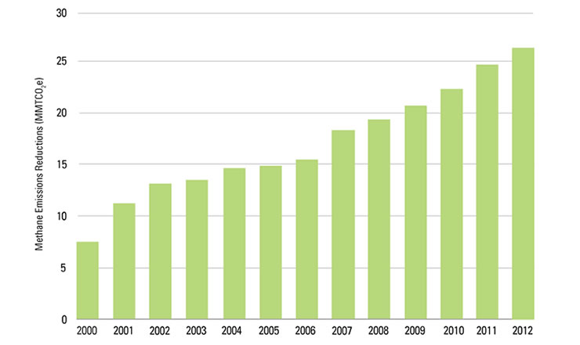
Landfill Methane - LMOP Emission Reductions

